Slide 1

Unit 03.02.01 CS 5220: COMPUTER COMMUNICATIONS
Packet Switching – Virtual Circuits
XIAOBO ZHOU, Ph.D.
Professor, Department of Computer Science

Slide 2
Packet Switching – Virtual Circuit
Packet
Packet
Packet
Packet
Virtual circuit
Call set-up phase sets ups pointers in fixed path along networks
All packets for a connection follow the same path
Abbreviated header identifies connection on each link
Variable bit rates possible, negotiated during call set-up
Physical-layer circuit vs Network-layer virtual circuit

Slide 3
Connection Setup
Connect request
Connect request
Connect request
SW 1
SW 2
…
SW n
Connect confirm
Connect confirm
Connect confirm
Signaling messages propagate as route is selected
Signaling messages identify connection and setup tables in switches
Typically a connection is identified by a local tag, Virtual Circuit Identifier (VCI)
Each switch only needs to know how to relate an incoming tag in one input to an outgoing tag in the corresponding output
Once tables are setup, packets can flow along path

Slide 4
Virtual Circuit Forwarding Tables
Input
VCI
Output
port
Output
VCI
Each input port of packet switch has a forwarding table
Lookup entry for per-link/port VCI of incoming packet
Determine output port (next hop) and insert VCI for next link
Very high speeds are possible (HW-based)
Table can also include priority or other information about how packet should be treated
12
13
44
15
15
23
27
13
16
58
7
34

Slide 5
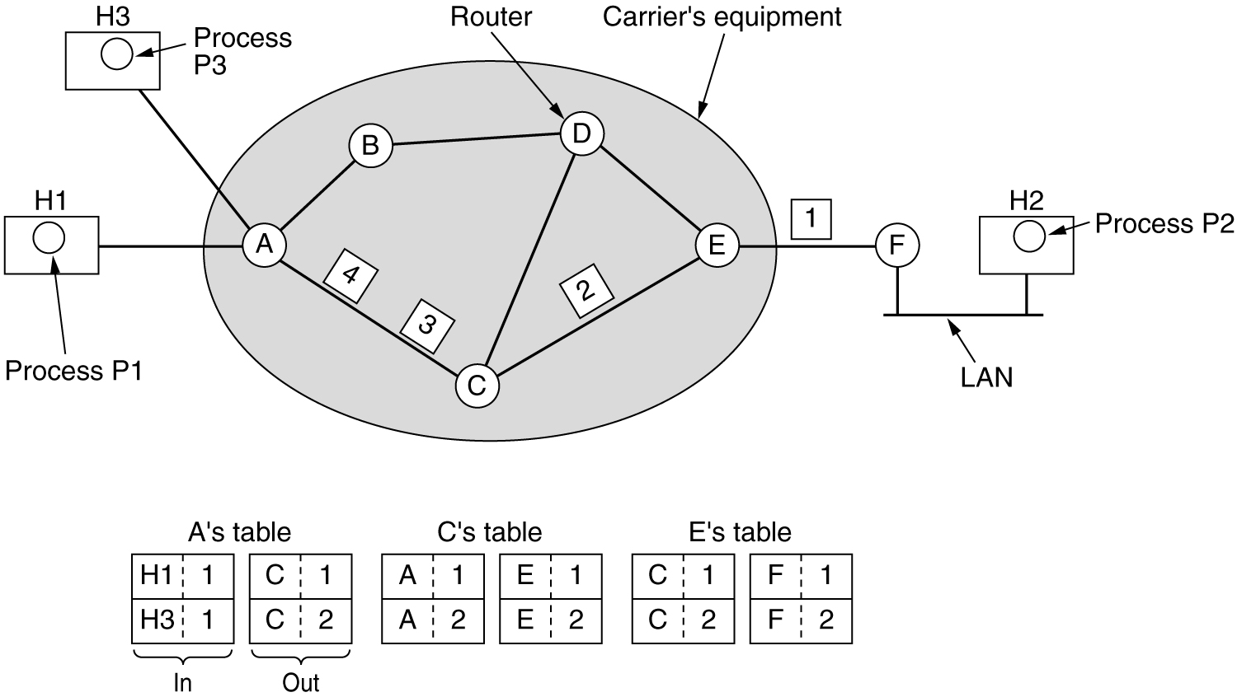
Routing in Virtual Circuit Subnet
Label switching

Slide 6
Virtual Circuit w/ Connection Setup Delay
t
Connect request
1
2
3
CC
t
CR
1
2
3
Release
CC
t
CR
Connect confirm
1
2
3
t
Connection setup delay is incurred before any packet can be transferred
Delay is acceptable for sustained transfer of large number of packets
This delay may be unacceptably high if only a few packets are being transferred

Slide 7
Example: ATM Networks
All information mapped into short fixed-length packets called cells
Connections set up across network
Virtual circuits established across networks
Tables setup at ATM switches
Several types of network services offered
Constant bit rate connections
Variable bit rate connections

Slide 8
Cut-Through Switching
Source
t
Switch 1
1
2
3
t
1
2
3
Switch 2
t
1
2
3
t
Destination
Minimum delay = 3τ + T
Some networks perform error checking on header only, so packets can be forwarded as soon as header is received & processed
Delays reduced further with cut-through switching

Slide 9
Message vs. Packet Minimum Delay
Message switching:
L τ + L T = L τ + (L – 1) T + T
Packet switching with store-and-forward
L τ + L P + (k – 1) P = L τ + (L – 1) P + T
Cut-Through Packet switching (Immediate forwarding after header) = L τ + T
Above measurements neglect header processing delays

Slide 10
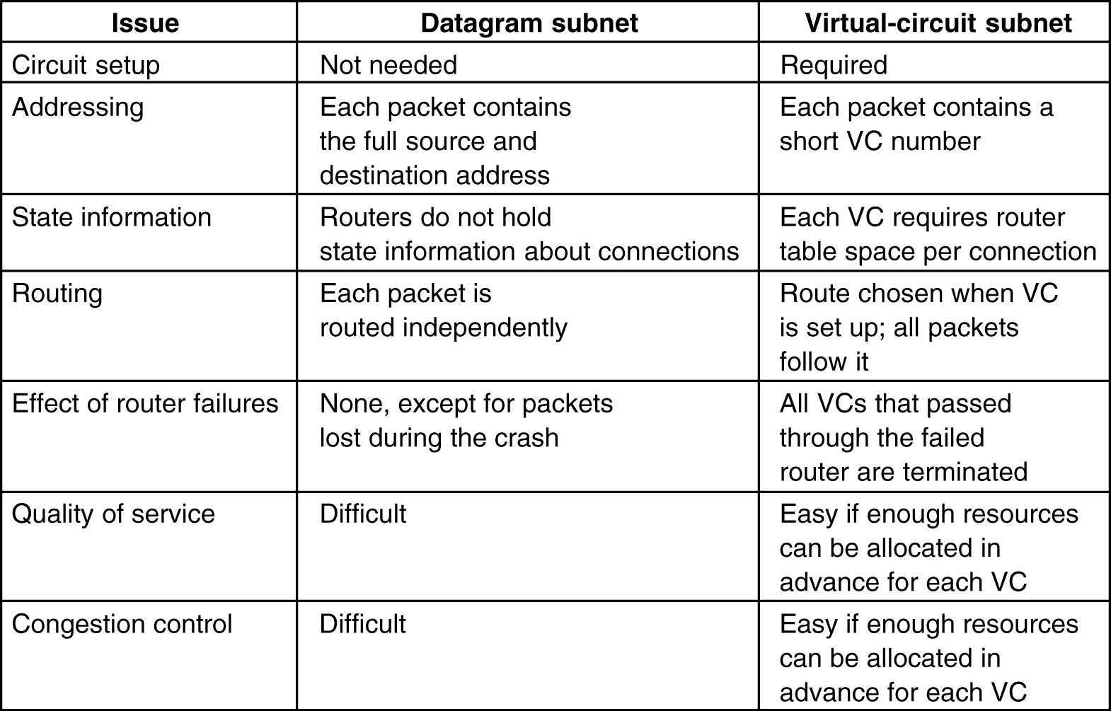
5-4

